Slide 1

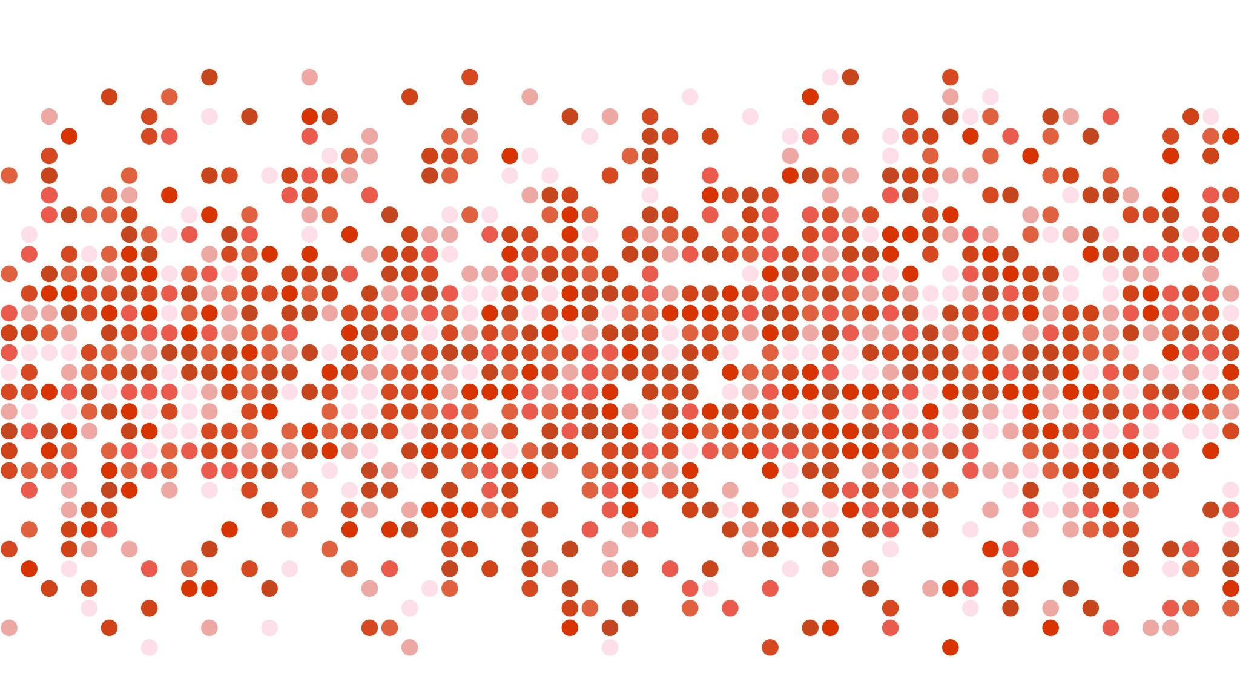
US Airline Sentiment Analysis
MGSC 410 Homework 1
JJ Goh

Slide 2
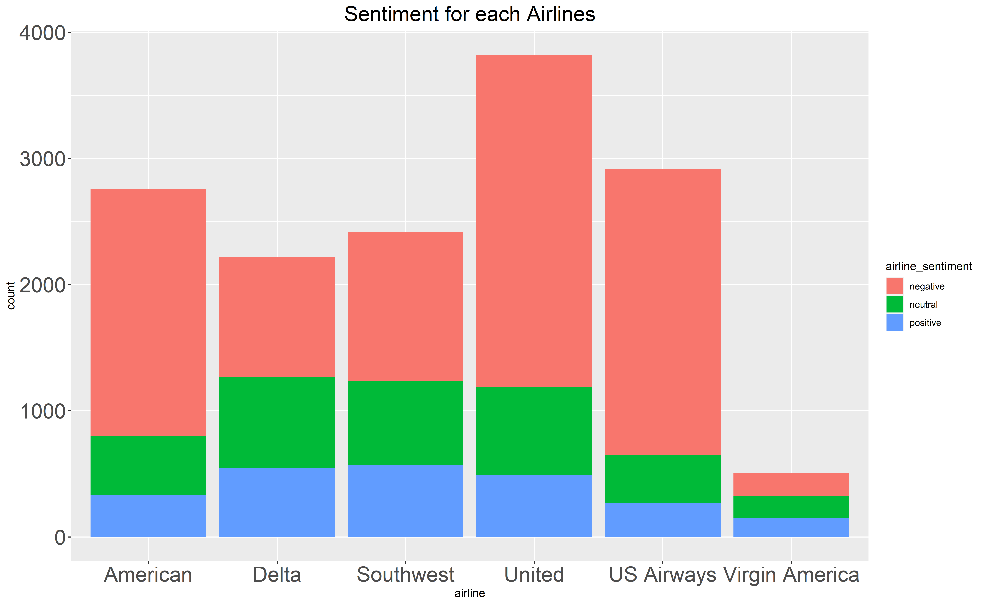
Overall Sentiment for each Airlines
Majority of the tweets are negative (62%)
United, US Airways and American are the top 3 airlines that was tweeted about during this time period
Virgin America was the airline that was least tweeted about
Next, I focused on the negative reasons

Slide 3
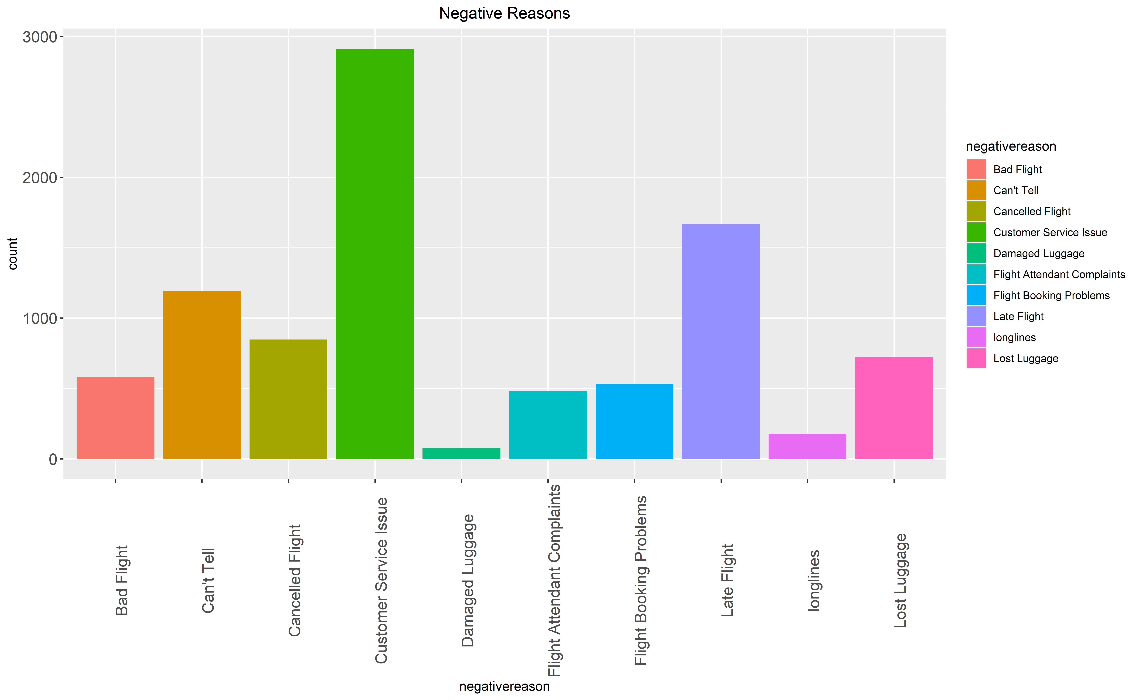
Negative Reasons
Top negative reason across all airlines is Customer Service Issue
Second highest negative reason is late flights
Next, I looked at the negative reasons by Airlines

Slide 4
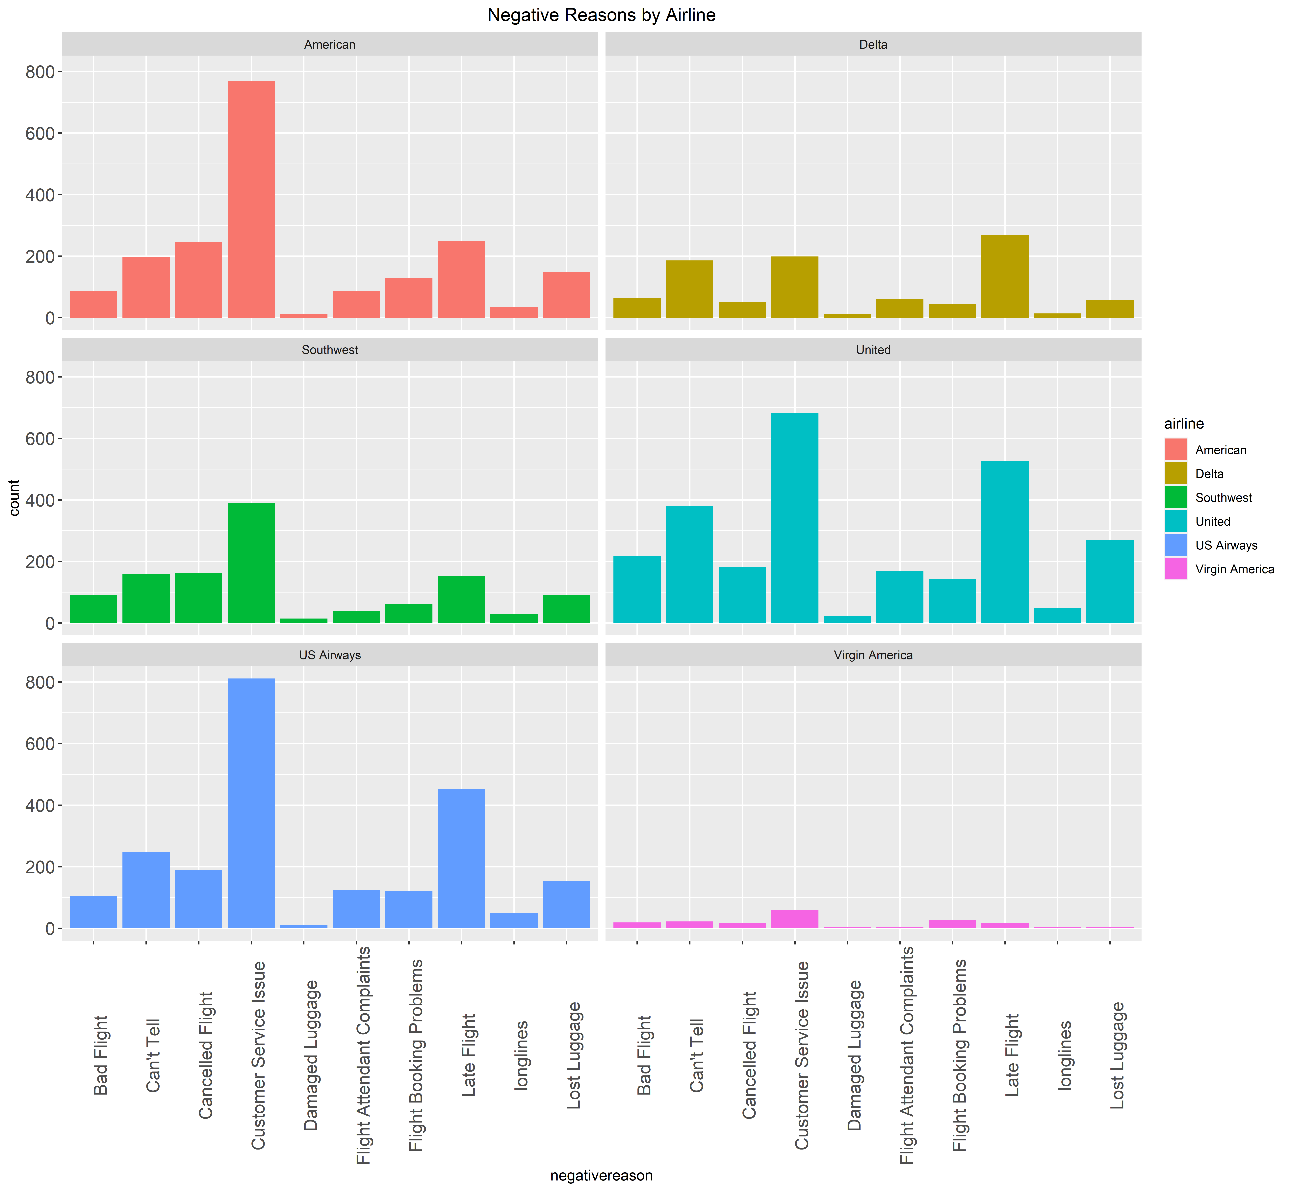
Negative Reasons by Airline
US Airways, American, and United has the highest amount of Customer Service Issue
Delta’s main negative reason is due to late flights
Late flights are also US Airways’, American’s, and United’s next top negative reason
Virgin American has the least complaints among all other airlines in this dataset

Slide 5
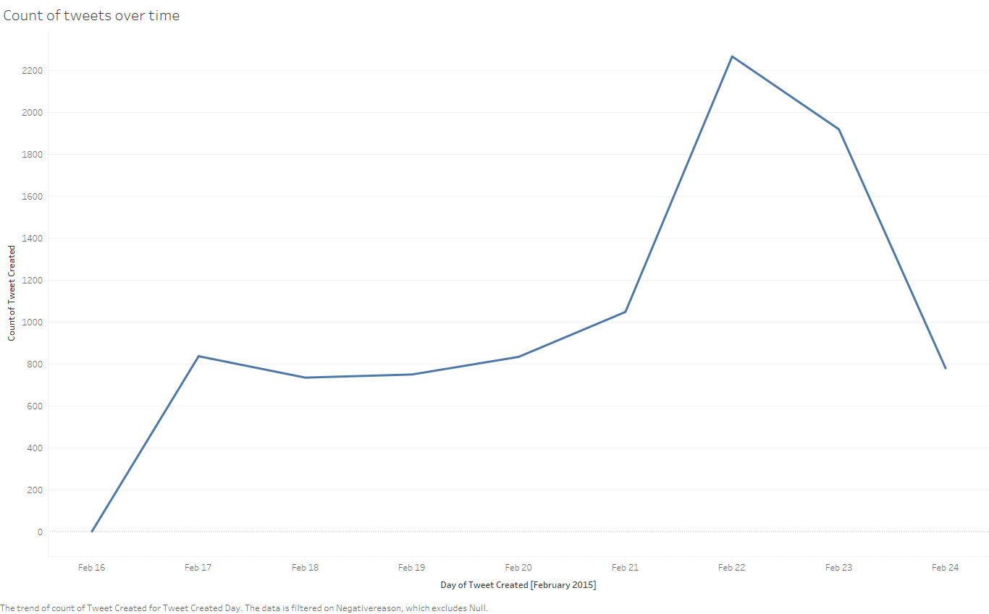
Count of Tweets over time
The number of tweets increased sharply from February 16 to February 17
Tweets increased significantly on February 22 and started to drop drastically February 23 onwards
Reason for rapid increase in tweets might be because February 22 is a Sunday and people might be travelling on the weekend
People might still be tweeting about their experiences on February 23 (Monday).

Slide 6
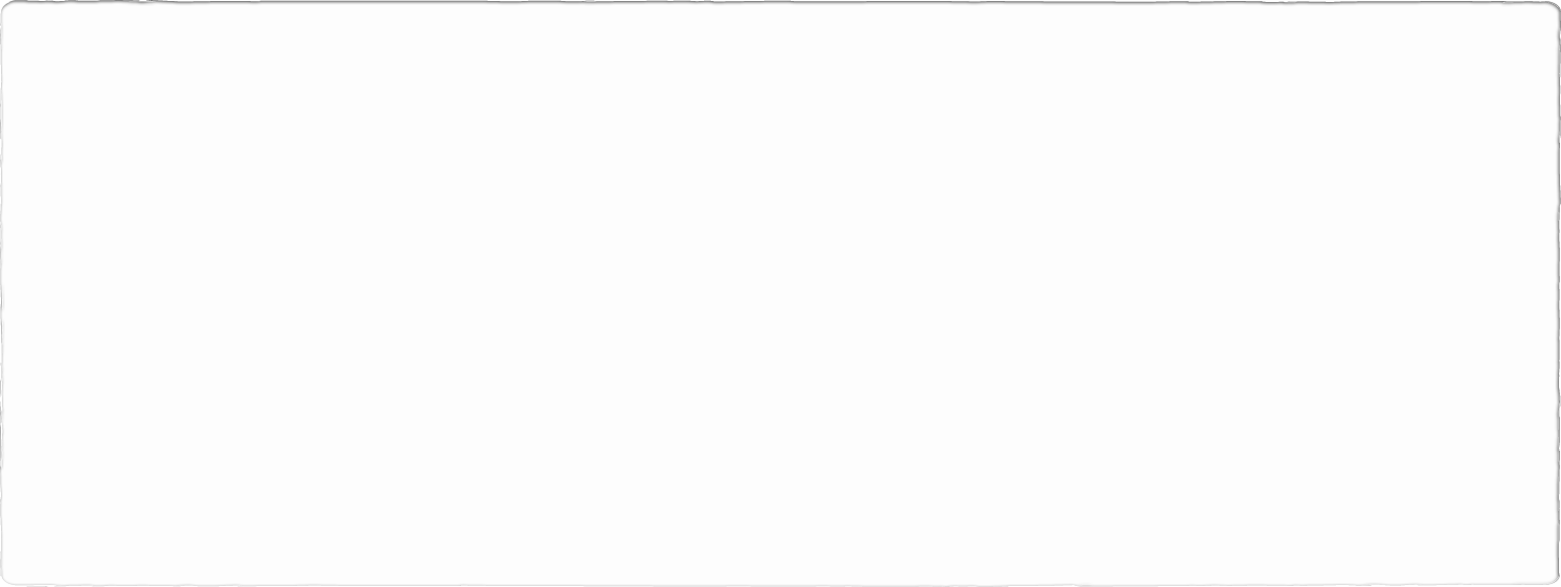
Count of Sentiment of Tweets over Time

Slide 7
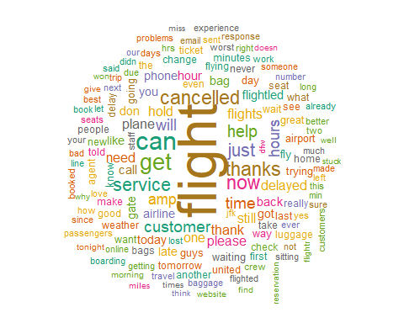
Word Cloud
Cleaned texts and analyzed for the top 150 words tweeted across the dataset
Words such as ‘flight’, ‘cancelled’, ‘delayed’, ‘hold’ and ‘thanks’ appeared the most
Although thanks/thank might have a positive connotation, it is important to note that the tweet might be sarcastic and might imply a negative sentiment

Slide 8
Word Frequencies for each Airline
Calculated word frequencies for each airline (refer to appendix for graph)
Words near the line represents the same amount of frequency used while words further away from line are used much more by one Airline compared to the other
Airline | Similar Words
Delta/American | Time, Flight, Cancelled, Malfunction, Lost
US Airway/Virgin America | Answering, cancelled, LGA, Reschedule, Online
United/Southwest | Customer, Bag, Hours, Wi-Fi, Honest

Slide 9
Comparing Word Usage
Used log odds ratio to compare what words will most/least likely to be associated with each airline (refer to graphs in appendix)
Airline | Top associated words
American | DFW (Terminal in Dallas), Automated, Rebooked
Delta | Fleek, CEO, Battles
Virgin America | Deals, Austin, Incredible, Win
US Airways | Miles, Rude, Issues, Worst
United | Supervisor, Premier, Milage
Southwest | DestinationDragons, SWA, luv

Slide 10
Key Findings
62% of tweets were negative
United Airlines was the most tweeted about from February 16 to February 24
Top negative reason was due to customer service issue
Virgin America has the least negative reasons
People tweeted the most on February 22 (Sunday)
US Airways frequented a lot of negative words and is most likely to be associated with negative words
Virgin America is most likely to be associated with positive words

Slide 11
Appendix
Graph 1.1 – Word Frequency for Delta/American
Graph 1.2 – Word Frequency US Airway/Virgin America
Graph 1.3 – Word Frequencies for United/Southwest
Graph 2.1 – Word Usage for Delta/American
Graph 2.2 – Word Usage for US Airway/Virgin America
Graph 2.3 – Word Usage for United/Southwest

Slide 12
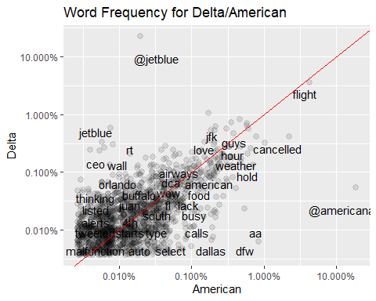
1.1 Word Frequency for Delta/American

Slide 13
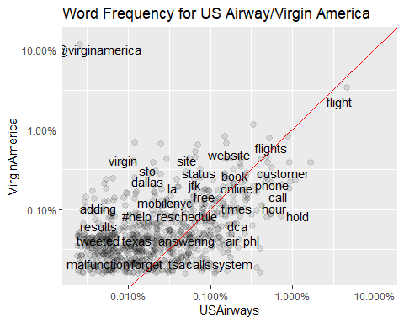
1.2 Word Frequency for US Airway/Virgin America

Slide 14
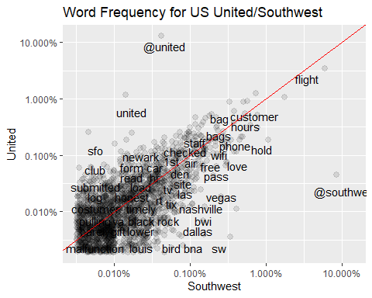
1.3 Word Frequency for United/Southwest

Slide 15
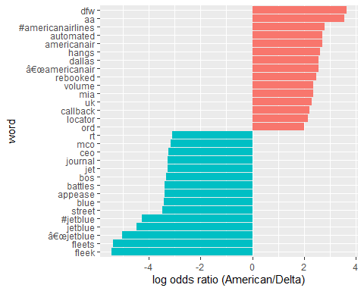
2.1 Word Usage for Delta/American

Slide 16
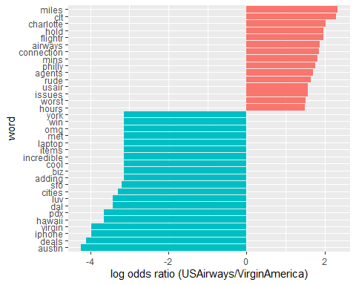
2.2 Word Usage for US Airway/Virgin America

Slide 17
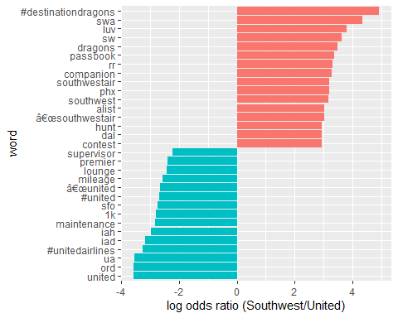
2.3 Word Usage for United/Southwest

